Slide 1
Systems Analysis and Design 11th Edition
Chapter 4
Requirements Modeling

Slide 2
Chapter Objectives
Describe systems analysis phase activities
Explain joint application development (JAD), rapid application development (RAD), and agile methods
Use a functional decomposition diagram (FDD) to model business functions and processes
Describe the Unified Modeling Language (UML) and examples of UML diagrams

Slide 3
Chapter Objectives (Cont. 1)
List and describe system requirements, including outputs, inputs, processes, performance, and controls
Explain the concept of scalability
Use fact-finding techniques, including interviews, documentation review, observation, questionnaires, sampling, and research

Slide 4
Chapter Objectives (Cont. 2)
Define total cost of ownership (TCO)
Conduct a successful interview
Develop effective documentation methods to use during systems development

Slide 5
Systems Analysis Phase Overview
Objectives
Understand the proposed project
Ensure that it supports business requirements
Build a solid foundation for system development
Systems Analysis Activities
Requirements modeling
Involves fact-finding to describe the current system and identification of the requirements for new system
Data and process modeling
Graphically represents system data and processes

Slide 6
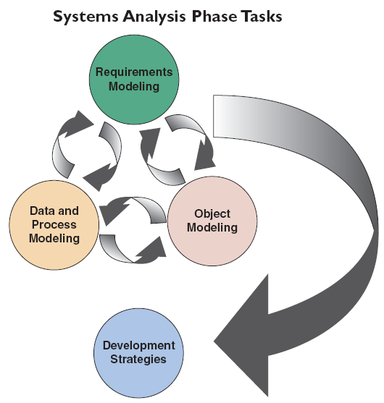
Systems Analysis Phase Overview (Cont. 1)
Object modeling
Involves creation of objects to represent people, things, transactions, and events
Development strategies
Include software trends, development alternatives, and outsourcing
FIGURE 4-2 The systems analysis phase consists of requirements modeling, data and process modeling, object modeling, and consideration of development strategies. Notice that the systems analysis tasks are interactive, even though the waterfall model generally depicts sequential development

Slide 7
Systems Analysis Phase Overview (Cont. 2)
Systems Analysis Skills
Strong analytical and interpersonal skills
Team-Based Techniques: JAD, RAD, and Agile Methods
Goal - To deliver the best possible system at the lowest possible cost in the shortest possible time
Joint application development (JAD) brings users into the design process
Rapid application development (RAD) is a condensed version of the system development life cycle
Agile methods stress intense interaction between developers and users

Slide 8
Joint Application Development
Brings users into the development process as active participants
User Involvement (formal or informal)
Helps create a successful system
JAD Participants and Roles
Project leader and one or more members
Participants should be insulated from distractions of day-to-day operations

Slide 9
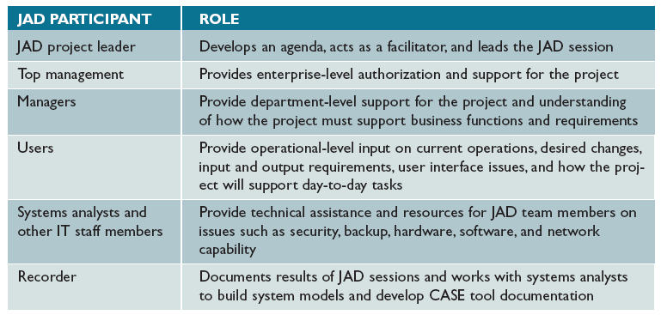
Joint Application Development (Cont. 1)
FIGURE 4-3 Typical JAD participants and roles

Slide 10
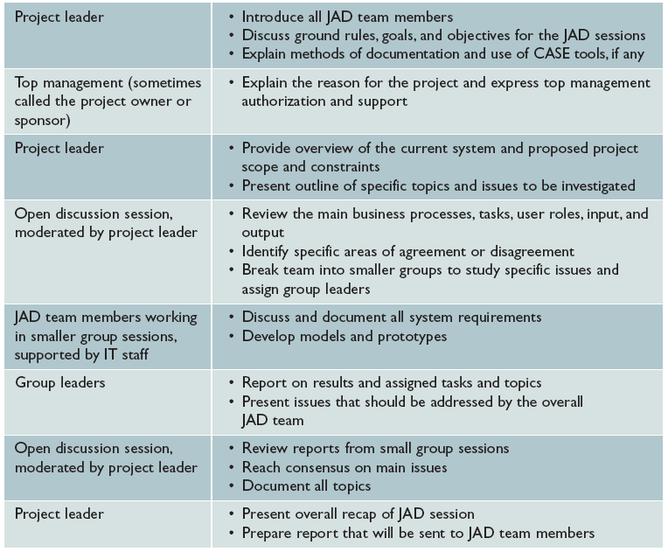
Joint Application Development (Cont. 2)
FIGURE 4-4 Typical agenda for a JAD session

Slide 11
Joint Application Development (Cont. 3)
JAD Advantages and Disadvantages
Disadvantages
More expensive than traditional methods
Can be cumbersome if the group is too large
Advantages
Allows key users to participate effectively
Users are more likely to feel a sense of ownership
Produces a more accurate statement of system requirements, a better understanding of common goals, and a stronger commitment to the success of the new system

Slide 12
Rapid Application Development
Uses a group approach like JAD
End product - New information system
Complete methodology
Includes a four-phase life cycle that parallels the traditional SDLC
Reduces cost and development time
Increases the probability of success
Relies on prototyping and user involvement
Prototypes are modified based on user input

Slide 13
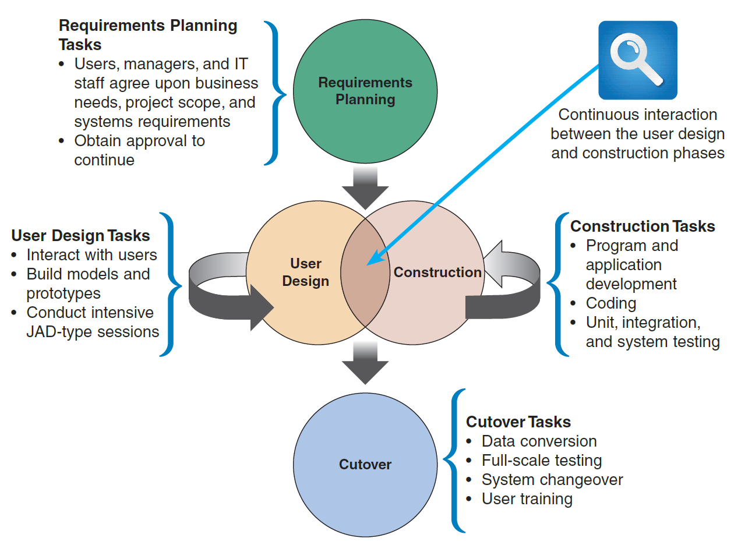
Rapid Application Development (Cont. 1)
FIGURE 4-5 The four phases of the RAD model are requirements planning, user design, construction, and cutover. Notice the continuous interaction between the user design and construction phases.

Slide 14
Rapid Application Development (Cont. 2)
RAD Objectives
Cut development time and expense
Involve users in every phase of systems development
Must have the right IT resources, skills, and management support
RAD Advantages and Disadvantages
Advantage – Helps develop systems quickly with significant cost savings
Disadvantages
Does not emphasize the company’s strategic business needs
Less time to develop quality, consistency, and design standards

Slide 15
Agile Methods
Attempt to develop a system incrementally, by building a series of prototypes and adjusting them to user requirements regularly
Developers revise, extend, and merge earlier versions into the final product
Emphasize continuous feedback
Each incremental step is affected by what was learned in the prior steps

Slide 16
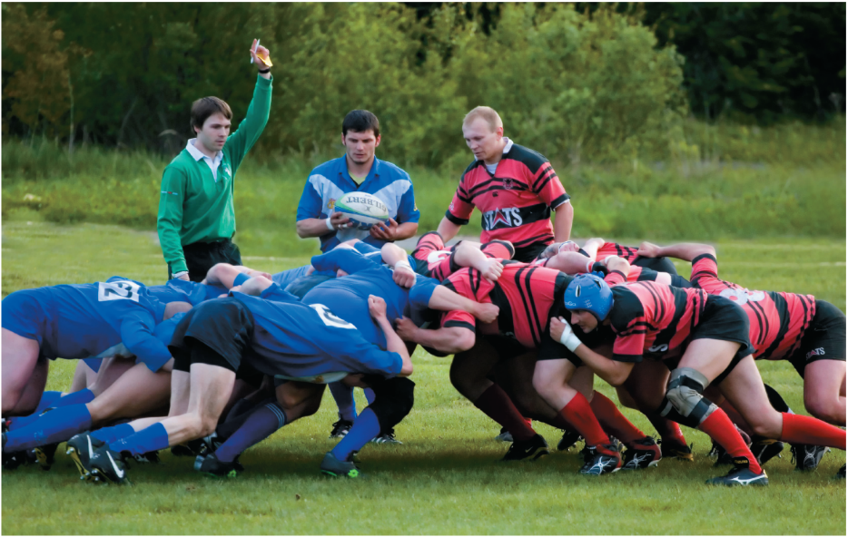
Agile Methods (Cont. 1)
Scrum
A rugby term
Pigs include the product owner, the facilitator, and the development team
Chickens include users, other stakeholders, and managers
Scrum sessions
Have specific guidelines that emphasize time blocks, interaction, and team-based activities that result in deliverable software
FIGURE 4-7 In a rugby scrum, team members prepare to lunge at each other to achieve their objectives.
fotograf.lv / Shutterstock.com

Slide 17
Agile Methods (Cont. 2)
Agile Method Advantages and Disadvantages
Advantages
Very flexible and efficient in dealing with change
Frequent deliverables constantly validate the project and reduce risk
Disadvantages
Team members need a high level of technical and interpersonal skills
Lack of structure and documentation can introduce risk factors
May be subject to significant change in scope

Slide 18
Modeling Tools and Techniques
Involve graphical methods and nontechnical language that represent the system at various stages of development
Systems analysts:
Build fact-finding results into models
Study the models to determine whether additional fact-finding is needed
Functional Decomposition Diagrams (FDD)
Top-down representation of a function or process
Help analysts show business functions and how they are organized into lower-level processes

Slide 19
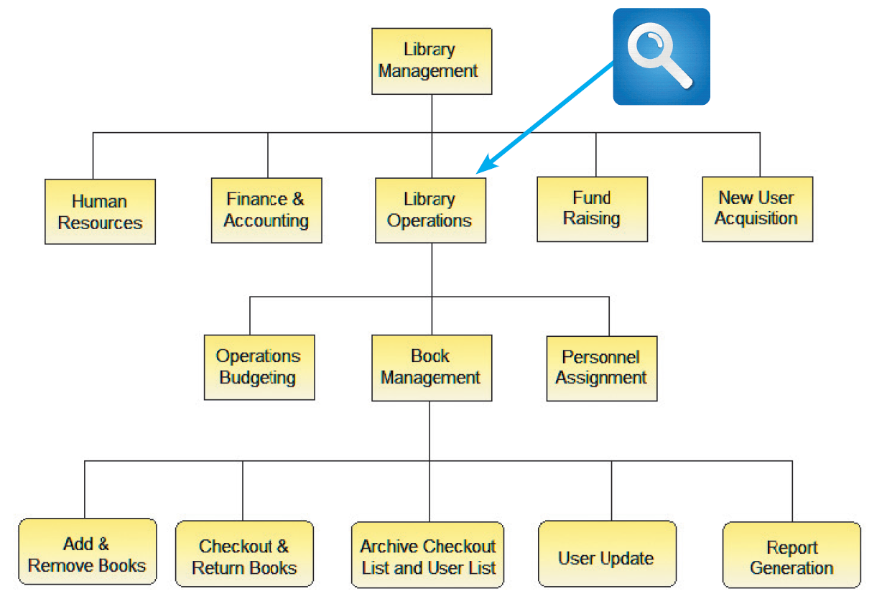
Modeling Tools and Techniques (Cont. 1)
FIGURE 4-8 This Visible Analyst FDD shows a library system with five top-level functions. The Library Operations function includes two additional levels of processes and sub processes. Source: Visible Systems Corporation.

Slide 20
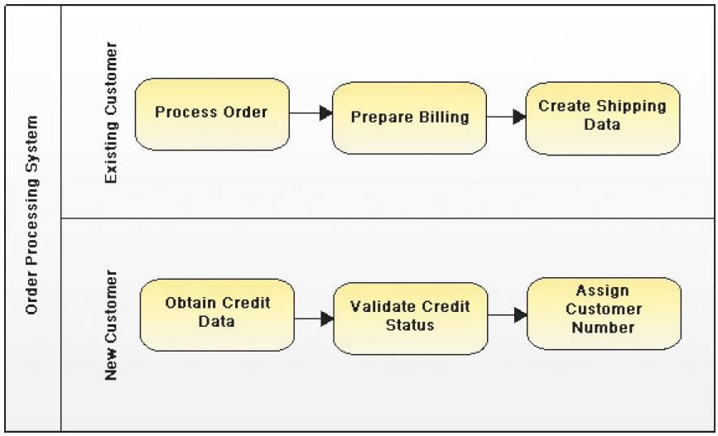
Modeling Tools and Techniques (Cont. 2)
Business Process Modeling (BPM)
Represents one or more business processes
Business process modeling notation (BPMN)
Models that use a standard language
Includes shapes and symbols to represent events, processes, and workflows
FIGURE 4-9 Using the Visible Analyst CASE tool, an analyst can create a business process diagram. The overall diagram is called a pool, and the two separate customer areas are called swim lanes.
Source: Visible Systems Corporation.

Slide 21
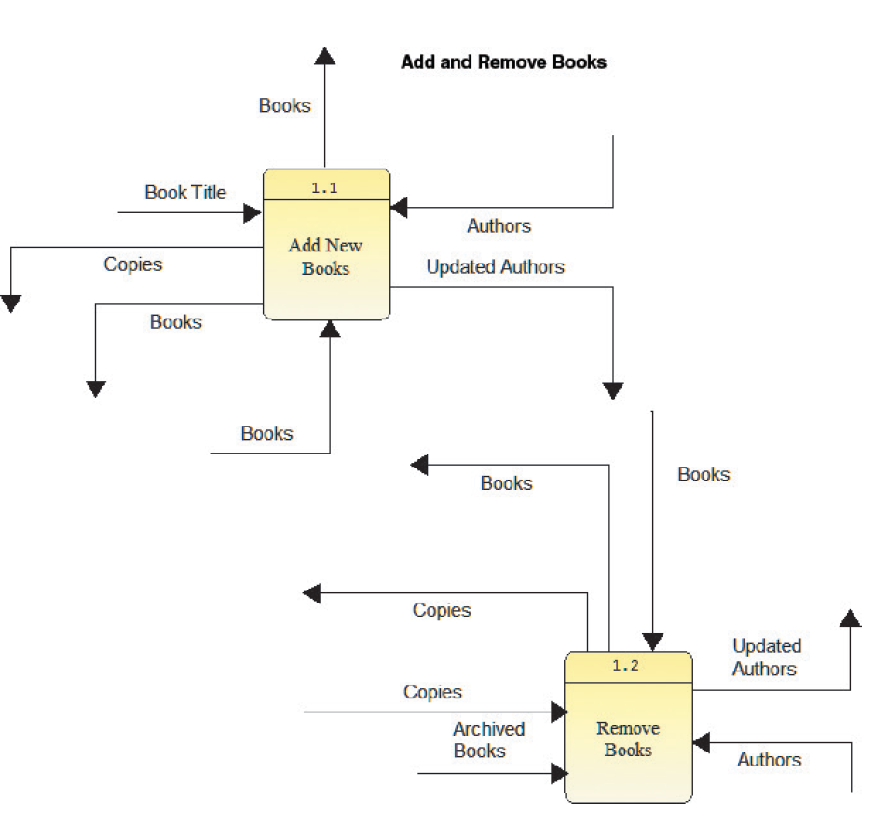
Modeling Tools and Techniques (Cont. 3)
Data Flow Diagrams (DFD)
Show how the system stores, processes, and transforms data
Additional levels of information and detail are depicted in other, related DFDs
FIGURE 4-10 This Visible Analyst DFD shows how books are added and removed in a library system. Source: Visible Systems Corporation.

Slide 22
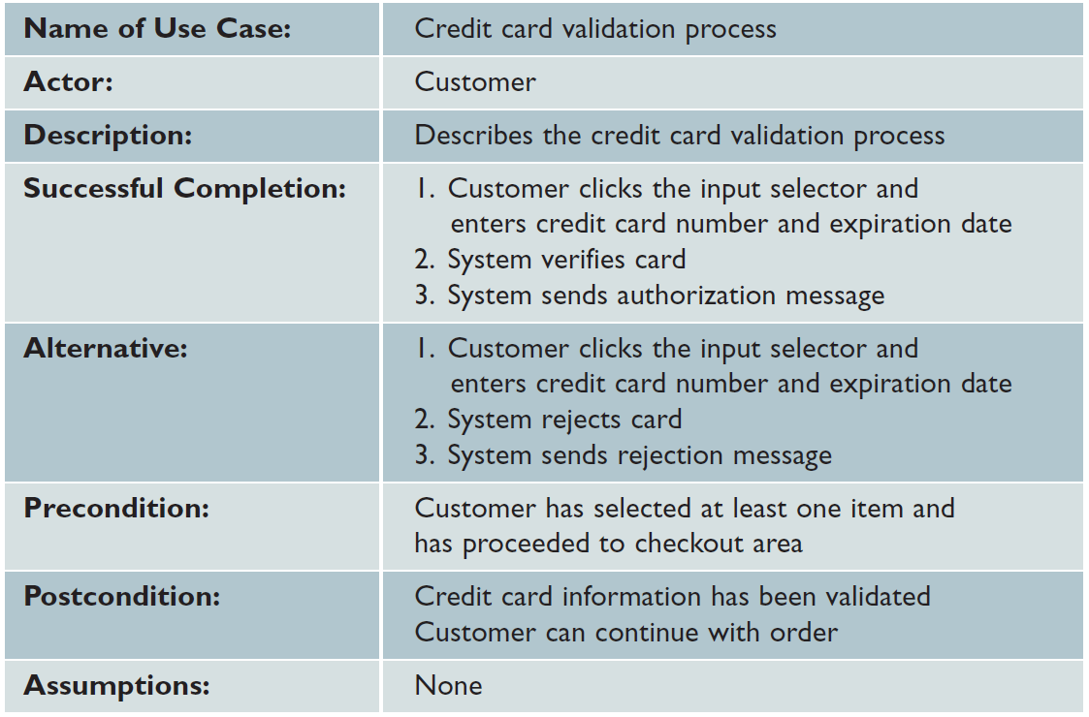
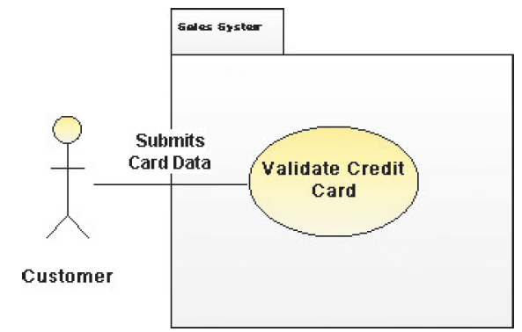
Modeling Tools and Techniques (Cont. 4)
Use Case Diagrams
Represent the interaction between users and the system
FIGURE 4-12 This table documents the credit card validation use case shown in Figure 4-11.
FIGURE 4-11 This Visible Analyst use case diagram shows a sales system, where the actor is a customer and the use case is a credit card validation.
Source: Visible Systems Corporation

Slide 23
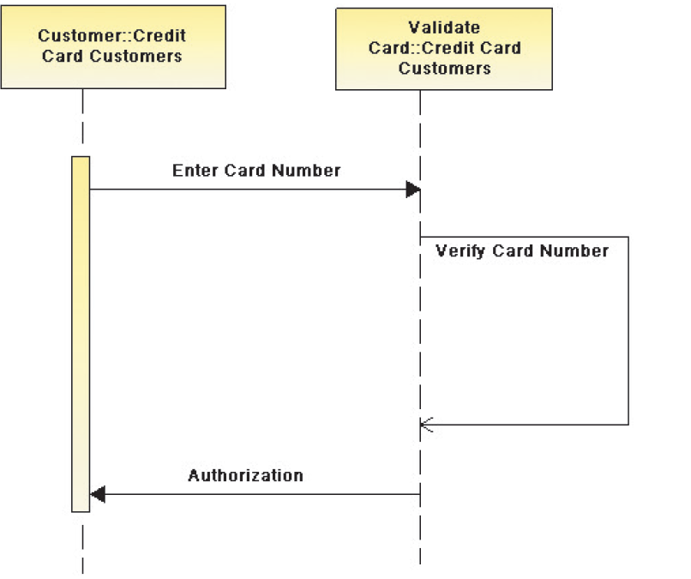
Modeling Tools and Techniques (Cont. 5)
Sequence Diagrams
Show the timing of interactions between objects as they occur
FIGURE 4-14 This Visible Analyst sequence diagram shows a credit card validation process.
Source: Visible Systems Corporation

Slide 24
System Requirements Checklist
Output Examples
The Web site must report online volume statistics every four hours, and hourly during peak periods
The contact management system must generate a daily reminder list for all sales reps
The purchasing system must provide suppliers with up-to-date specifications

Slide 25
System Requirements Checklist (Cont. 1)
Input Examples
The department head must enter overtime hours on a separate screen
Student grades must be entered on machine-readable forms prepared by the instructor
Each input form must include date, time, product code, customer number, and quantity
Process Examples
The student records system must calculate the GPA at the end of each semester
The human resources system must interface properly with the existing payroll system

Slide 26
System Requirements Checklist (Cont. 2)
The prescription system must automatically generate an insurance claim form
Performance Examples
The system must support 25 users online simultaneously
Response time must not exceed four seconds
The system must be operational seven days a week, 365 days a year

Slide 27
System Requirements Checklist (Cont. 3)
Control Examples
The system must provide logon security at the operating system level and at the application level
The system must maintain separate levels of security for users and the system administrator
All transactions must have audit trails
The system must create an error log file that includes the error type, description, and time

Slide 28
Future Growth, Costs, and Benefits
Scalability
A system’s ability to handle increased business volume and transactions in the future
A scalable system offers a better return on the initial investment
Information required to evaluate scalability
Projected future volume for all outputs, inputs, and processes

Slide 29
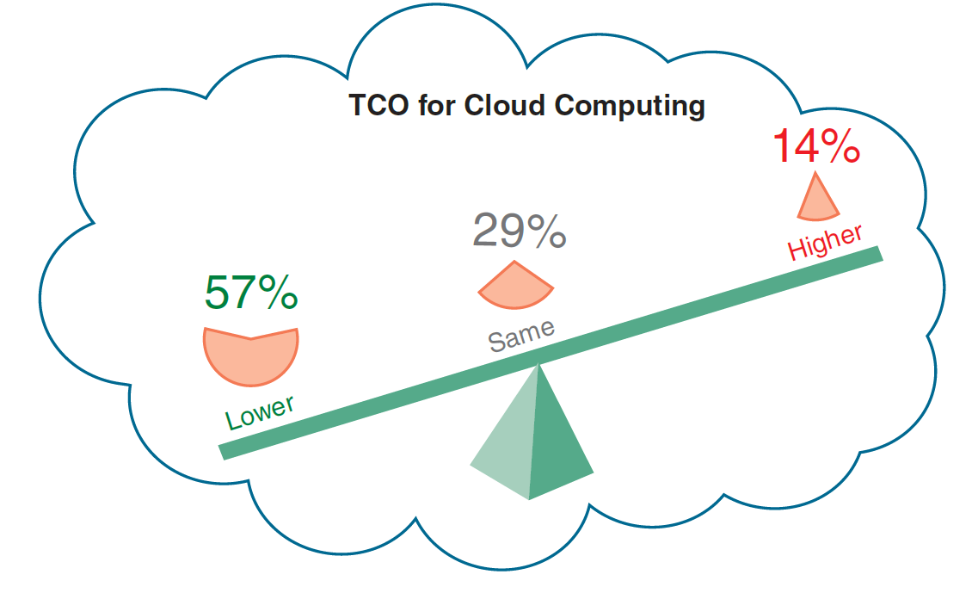
Future Growth, Costs, and Benefits (Cont.)
Total Cost of Ownership
Important if the development team is evaluating several alternatives
Problem - Cost estimates tend to understate indirect costs
Systems analysts should try to identify indirect costs and include them in TCO estimates
FIGURE 4-15 Total cost of ownership when migrating to the cloud can be significantly less
than current computing platforms.

Slide 30
Fact Finding
Fact-Finding Overview
Identify the required information - Typical questions to ask
What business functions are supported by the current system?
What are the benefits and TCO of the proposed system?
What transactions will the system process?
Must the new system interface with legacy systems?
Develop a fact-finding plan

Slide 31
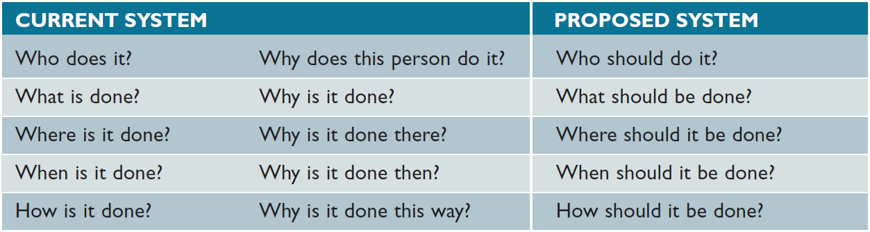
Fact Finding (Cont. 1)
Who, What, Where, When, How, and Why?
Systems analyst must first understand the current situation
Will help him/her tackle the question of what should be done
FIGURE 4-17 Sample questions during requirements modeling as the focus shifts from the current system to the proposed system.

Slide 32
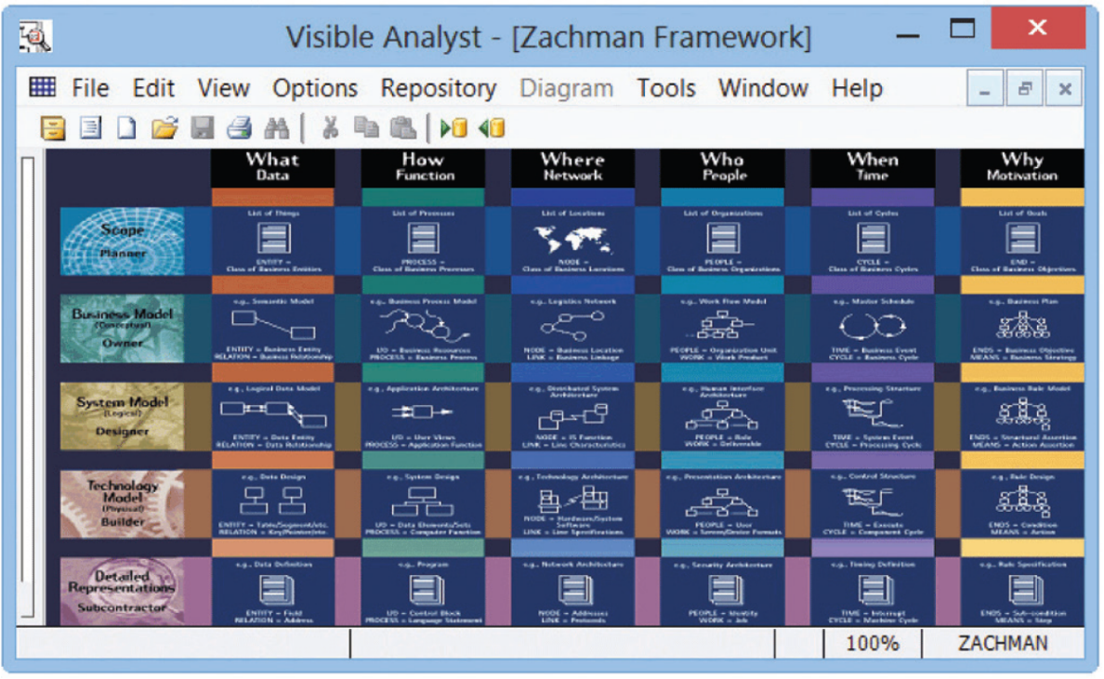
Fact Finding (Cont. 2)
The Zachman Framework
Helps managers and users understand the model
Ensures that overall business goals translate into successful IT projects
FIGURE 4-17 Visible Analyst uses the Zachman Framework for Enterprise Architecture. The Zachman concept presents traditional fact-finding questions in a systems development context.
Source: Visible Systems Corporation

Slide 33
Interviews
Steps involved
Step 1 - Determine the people to interview
Step 2 - Establish objectives for the interview
Step 3 - Develop interview questions
Step 4 - Prepare for the interview
Step 5 - Conduct the interview
Step 6 - Document the interview
Step 7 - Evaluate the interview

Slide 34
Interviews (Cont. 1)
Step 1 - Determine the People to Interview
Select the right people and ask the right questions
Consider candidates from both formal and informal structures
Decide on group and/or individual interviews
Step 2 - Establish Objectives for the Interview
Determine the areas to be discussed
List the facts that need to be gathered
Objectives depend on the role of the person being interviewed

Slide 35
Interviews (Cont. 2)
Step 3 - Develop Interview Questions
Decide what to ask and how to phrase the question
Avoid leading questions
Open ended questions encourage spontaneous and unstructured responses
Close ended questions limit the response
Used to verify facts
Range-of-response questions limit the response
Use a numeric scale

Slide 36
Interviews (Cont. 3)
Step 4 - Prepare for the Interview
Careful preparation is essential
Limit the interview to no more than one hour
Verify time, place, length, and topics via e-mail
If there are questions about documents, ask the interviewee to have samples available at the meeting

Slide 37
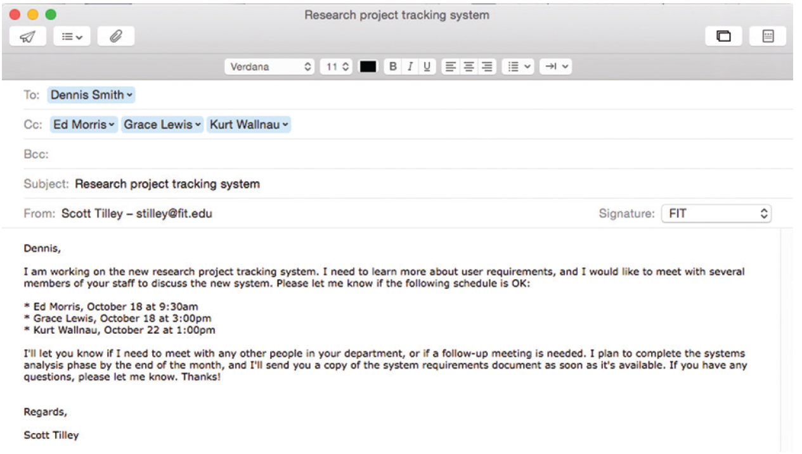
Interviews (Cont. 4)
FIGURE 4-19 Sample message to a department head about interviews.
Source: 2015 Apple

Slide 38
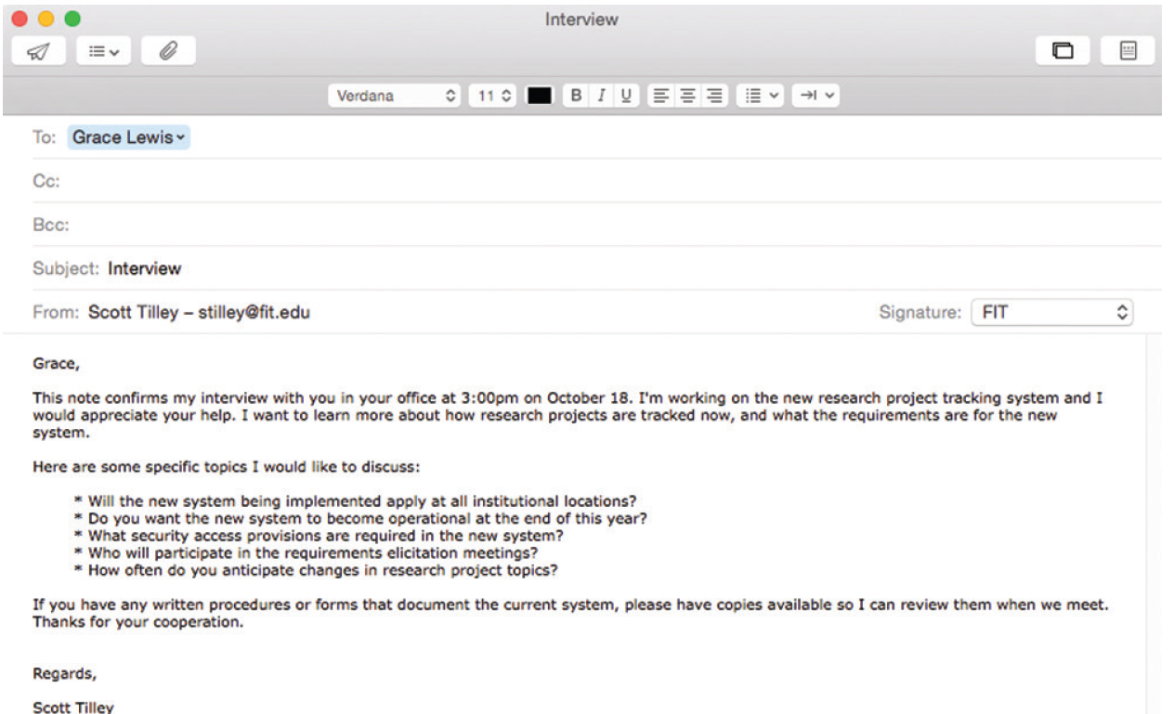
Interviews (Cont. 5)
FIGURE 4-20 Sample message to confirm an interview.
Source: 2015 Apple

Slide 39
Interviews (Cont. 6)
Step 5 - Conduct the Interview
Develop a specific plan for the meeting
Begin by introducing yourself, describing the project, and explaining your interview objectives
Practice engaged listening
Allow the person enough time to think about the question and arrive at an answer
After an interview, summarize the session and seek a confirmation

Slide 40
Interviews (Cont. 7)
Step 6 - Document the Interview
Note taking should be kept to a minimum
After conducting the interview:
Record the information quickly
Send memo to the interviewee expressing your appreciation
Note the date, time, location, purpose of the interview, and the main points you discussed so the interviewee has a written summary and can offer additions or corrections
Step 7 - Evaluate the Interview
In addition to recording the facts obtained in an interview, try to identify any possible biases

Slide 41
Interviews (Cont. 8)
Unsuccessful Interviews
No matter how well you prepare for interviews, some are not successful
Misunderstanding or personality conflict could affect the interview negatively, or the interviewee might be afraid that the new system will eliminate or change his or her job

Slide 42

Other Fact-Finding Techniques
Document Review
Review of baseline documentation
Helps an analyst understand how the current system is supposed to work
Observation
Provides additional perspective and a better understanding of the system procedures
Should be planned in advance
Figure 4-21 The Hawthorne study suggested that worker productivity improves during observation. Always consider the Hawthorne Effect when observing the operation of an existing system.
Monkey Business Images/Shutterstock.com

Slide 43
Other Fact-Finding Techniques (Cont. 1)
Questionnaires and Surveys
Make sure that the questions collect the right data in a form that can be used to further the fact finding effort
Can be traditional forms, fill-in forms, or forms from online survey websites
Fill-in form: Template used to collect data on the Internet or a company intranet

Slide 44
Other Fact-Finding Techniques (Cont. 2)
Suggestions for designing a questionnaire
Keep the questionnaire brief and user-friendly
Provide clear instructions
Arrange the questions in a logical order
Phrase questions to avoid misunderstandings
Try not to lead the response
Limit the use of open-ended questions that are difficult to tabulate
Limit the use of questions that can raise concerns about job security or other negative issues
Include a section for general comments
Test the questionnaire on a small test group before finalizing it and distributing to a large group

Slide 45
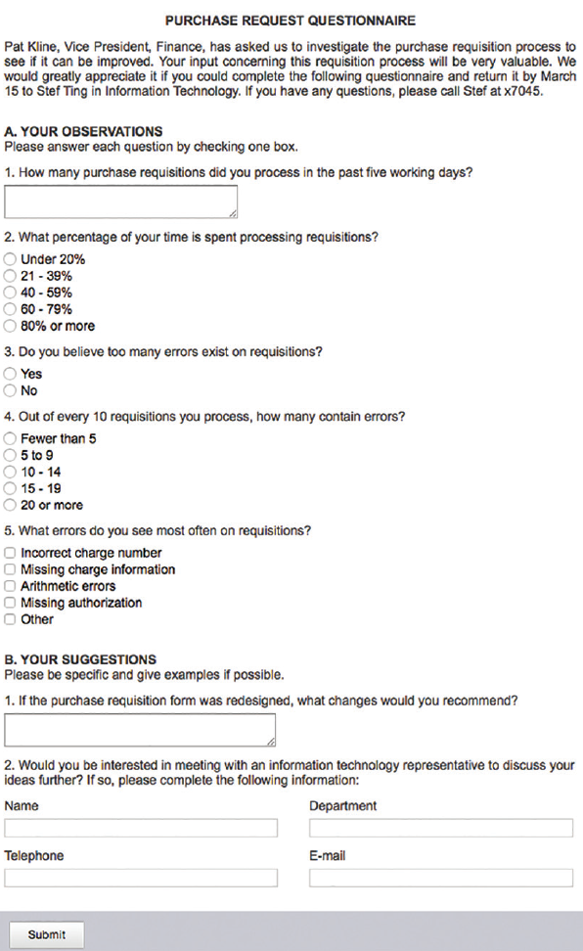
Other Fact-Finding Techniques (Cont. 3)
FIGURE 4-22 Online version of a sample questionnaire. Does it follow the suggested guidelines?
Created by author using Adobe Online Forms, Adobe Systems Incorporated

Slide 46
Other Fact-Finding Techniques (Cont. 4)
Interviews versus Questionnaires
Interview is more familiar and personal
Costly and time-consuming process
Questionnaire gives people the opportunity to provide input and suggestions
Recipients can answer the questions at their convenience
Brainstorming: Small group discussion of a specific problem, opportunity, or issue
Structured brainstorming
Unstructured brainstorming

Slide 47
Other Fact-Finding Techniques (Cont. 5)
Sampling
Systematic sample: Selection of every tenth customer for review
Stratified sample: Selection of five customers from each of four postal codes
Random sample: Selection of any 20 customers
Objective of a sample - To ensure that it represents the overall population accurately

Slide 48
Other Fact-Finding Techniques (Cont. 6)
Research
The Internet, IT magazines, and books to obtain background information, technical material, and news about industry trends and developments
Attending professional meetings, seminars, and discussions with other IT professionals
Site visits

Slide 49
Documentation
The Need for Recording the Facts
Principles for documentation
Record information as soon as it is obtained
Use the simplest recording method
Record findings in a way that they can be understood by someone else
Organize documentation so related material is located easily

Slide 50
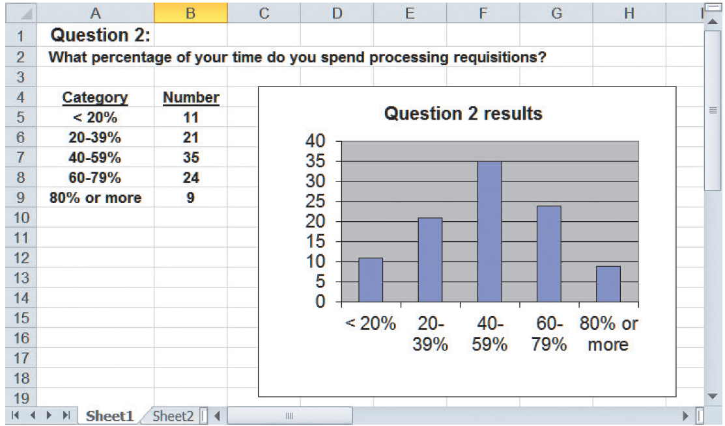
Documentation (Cont. 1)
Software Tools
CASE tools
Productivity software
Word processing
Spreadsheets
Database management
Presentation graphics
Collaborative software programs
FIGURE 4-24 This histogram displays the results from Question 2 in the questionnaire shown in Figure 4-22.

Slide 51
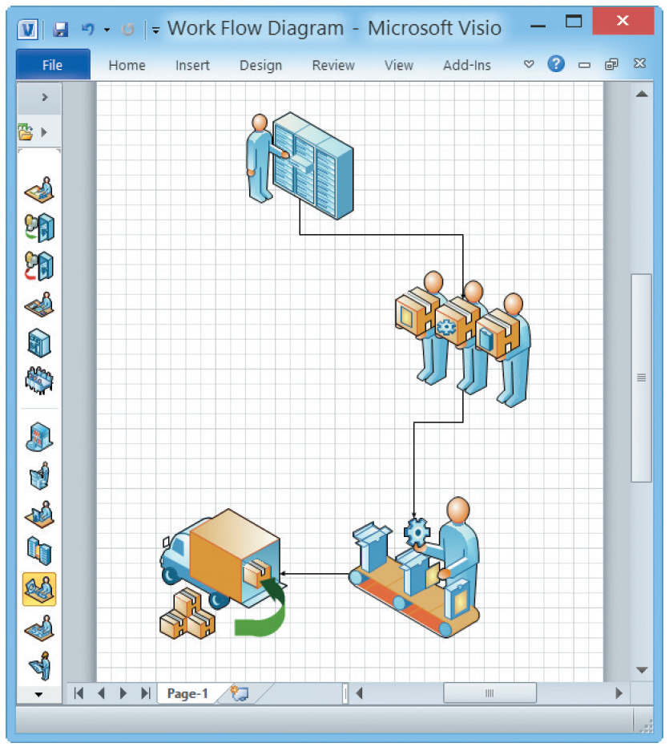
Documentation (Cont. 3)
Graphic Modeling Software
Help create charts and diagrams
Popular software
MS Visio
FIGURE 4-25 This Microsoft Visio drawing uses drag-and-drop shapes to represent a business process.
Source: Microsoft, LLC

Slide 52
Information Management Software
Personal Data Management Software
Microsoft Outlook
Includes a personal calendar, a to-do list with priorities and the capability to check off completed items, and powerful contact management features
Can manage email and appointments, and supports collaboration and team projects
Novell’s GroupWise
Evernote offers a free version of its popular information management software for most computing platforms, including smartphones and on the web.
Source: www.evernote.com

Slide 53
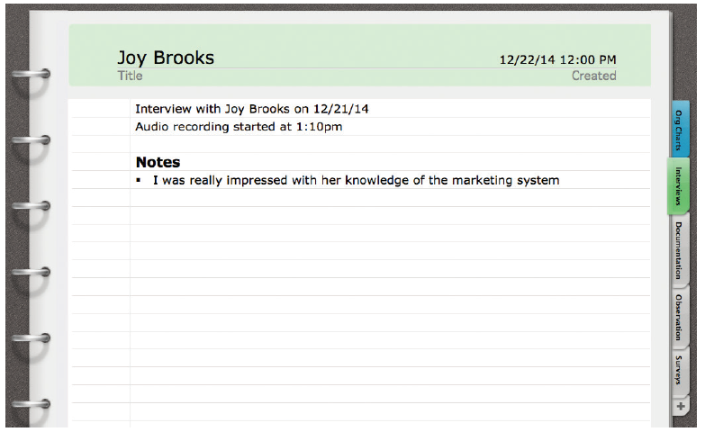
Information Management Software (Cont.)
Project Data Management
Microsoft OneNote
Handles different types of input, including text, handwritten notes, images, audio and video recordings, and web links
Microsoft Word
Recent versions provide note taking feature
FIGURE 4-26 The analyst is using Microsoft Word to store fact-finding results. During the interview with Joy Brooks, the analyst recorded part of the discussion and stored it as a document annotation.
Source: Microsoft Corporation.

Slide 54
Preview of Logical Modeling
At the conclusion of requirements modeling, systems developers should have a clear understanding of business processes and system requirements
Next step - To construct a logical model of the system
IT professionals have differing views about systems development methodologies, and no universally accepted approach exists

Slide 55
Chapter Summary
The systems analysis phase includes requirements modeling, data and process modeling, and consideration of development strategies
Objective is to understand the proposed project, ensure that it will support business requirements, and build a solid foundation for the systems design phase
Popular team-based approaches include JAD, RAD, and agile methods

Slide 56
Chapter Summary (Cont.)
The fact-finding process includes interviewing, document review, observation, questionnaires, sampling, and research
Systems analysts should carefully record and document factual information as it is collected, and various software tools can help an analyst visualize and describe an information system

